Slide 1
POWERPOINT PRESENTATION ON HOW THE COMMUNITY CONSUMES TECHNOLOGY
STUDENTS NAME
INSTITUTIONAL AFFILIATION
TOWN/CITY
DATE

Slide 2
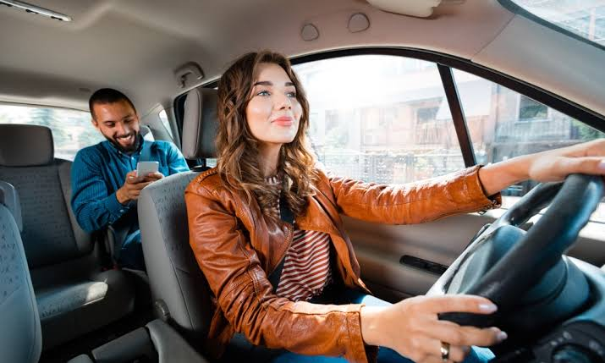
Requesting taxi.

Slide 3
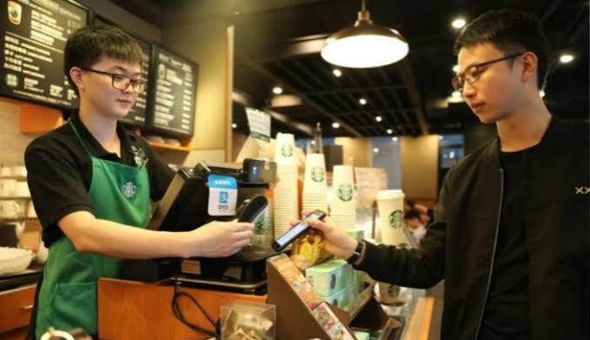
Digital payment

Slide 4
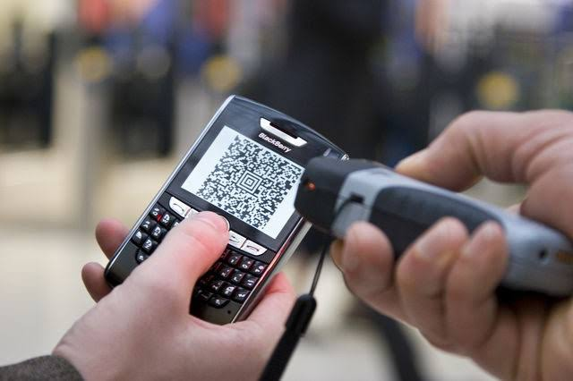
Rail ticketing

Slide 5
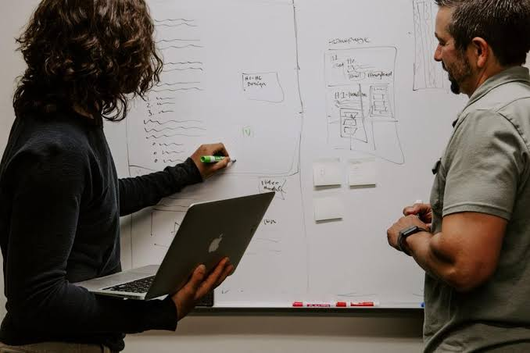
Academia / research

Slide 6
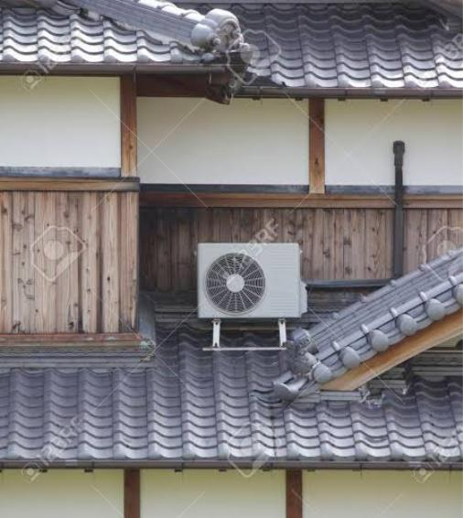
Air conditioning

Slide 7
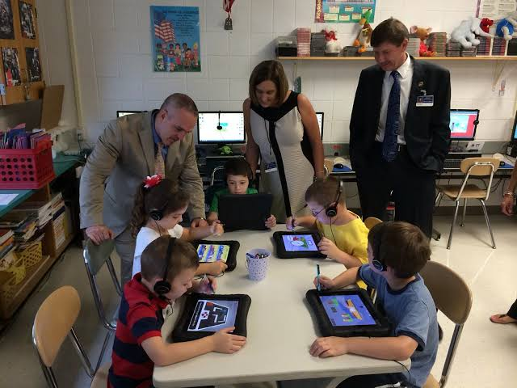
Student engagement

Slide 8
Summary.
Lets face it. The community we live in has been affected by the recent improvements in technology. The development in technology has seen a reduction of unemployment levels because of the creation of tech industries. Transportation has also been transformed because individuals are nowadays able to request for taxis using their mobile phones. Teaching has also improved a lot more because lecturers are able to store notes in their laptops and project them on the white board. Additionally, payments in stores has also shifted to cashless transaction. This is because of the rise in electronic payment systems which the stores have adopted.

